Slide 1
Global Economic Analysis on a Budget
Slides & More: www.kb.gg/georodeo
Kevin Booth

Slide 2
Who am I?
www.kb.gg/georodeo

Slide 3
Who am I?
www.kb.gg/georodeo
Graduate Student at Texas State University
Software Developer
NASA Johnson Space Center (Intern)
Swipejobs (Backend Developer)
Chaotic Moon Studios (Android Developer)
Dog Dad

Slide 4
Today’s Topic
www.kb.gg/georodeo

Slide 5
Building a Satellite Imagery Processing Pipeline
www.kb.gg/georodeo

Slide 6
A History Lesson
www.kb.gg/georodeo
Notes:
Government Shutdown on December 22
35 Days Long
GDP Report delayed by a month
GDP gives us the pulse of the economy
Used by the federal reserve to determine monetary policy

Slide 7
GDP Reports are Important
www.kb.gg/georodeo
Measures the pulse of our economy
Federal Reserve uses it to determine monetary policy
Investors use it to efficiently allocate resources
Valuing Ecosystem Services

Slide 8
Problems with GDP Reports
www.kb.gg/georodeo

Slide 9
Problems with GDP Reports
www.kb.gg/georodeo
Delayed by Government Shutdowns
Political Incentive to Under/Over Report
Reported for Administrative Units

Slide 10
Thesis
www.kb.gg/georodeo

Slide 11
Thesis
www.kb.gg/georodeo
Estimating GDP using Satellite Imagery
We previously used night-time imagery
Switching to SAR and Multispectral
Landsat Imagery
Measuring effectiveness of a technique

Slide 12
Thesis
www.kb.gg/georodeo
Austin, TX
Calculate Developed Area for 2002
Around 50 Landsat Scenes
Repeat for every year until 2012
Repeat for 199 more study areas
More than 100,000 scenes

Slide 13
Pipeline Steps
www.kb.gg/georodeo

Slide 14
Pipeline Steps
www.kb.gg/georodeo
Download Landsat Scenes
Convert to ToA Reflectance
Calculate Developed Area Index
Calculate Cloud Mask
Create Cloud Free Composite
Calculate Total Developed Area

Slide 15
Software
www.kb.gg/georodeo

Slide 16
Software
www.kb.gg/georodeo
Python
rasterio
python-fmask
Kubernetes
Airflow
PostgreSQL

Slide 17
Hardware
www.kb.gg/georodeo

Slide 18
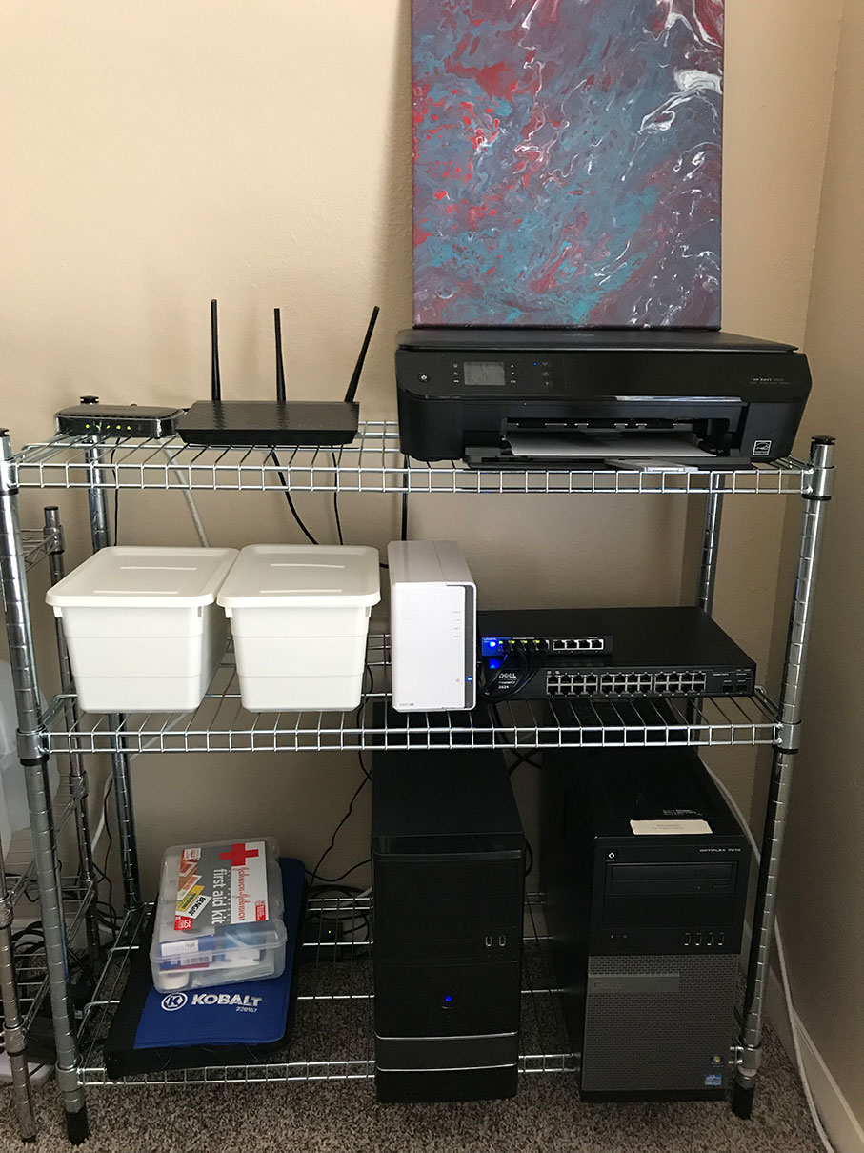
www.kb.gg/georodeo
Modem and Router

Slide 19
www.kb.gg/georodeo
Network Storage

Slide 20
www.kb.gg/georodeo
Gigabit Switch

Slide 21
www.kb.gg/georodeo
VirtualBox Host
K8s Master
Docker Registry
PostgreSQL

Slide 22
www.kb.gg/georodeo
K8s Node
Airflow
Processing Pods

Slide 23
Costs
www.kb.gg/georodeo
Modem and Router, Network Storage, and K8s Master
Already Had
Gigabit Switch
$35
K8s Node
$40
$45 – 16GB Memory
$30 – 240 GB SSD
Total: $150

Slide 24
www.kb.gg/georodeo

Slide 25
www.kb.gg/georodeo

Slide 26
Results
www.kb.gg/georodeo

Slide 27
Results
www.kb.gg/georodeo
1 Scene Processed in about 5.3 Minutes
4 scenes processed concurrently
1 scene every 1.325 minutes
1087 scenes per day
Landsat Program Scenes Captured per Day?
Around 1000

Slide 28
Unexpected Issues
www.kb.gg/georodeo

Slide 29
Unexpected Issues
www.kb.gg/georodeo
Managed Switch
Loud
Power hungry
DIY Pipeline Orchestration with Message Queuing
Difficult to debug
More code written for orchestrating than processing

Slide 30
Shameless Self-Promotion
www.kb.gg/georodeo

Slide 31
Q&A
www.kb.gg/georodeo

